Slide 1
核廢水模擬 林家屹
0523

Slide 2
作法
使用Matlab 把資料製作成opendrift 所需要的檔案格式
使用example_radionuclides 試算 1、5、10、14年的模擬

Slide 3
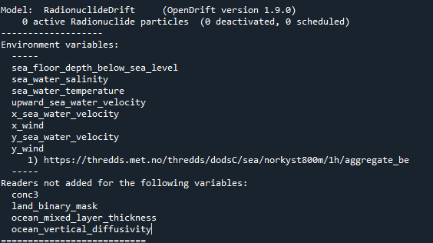
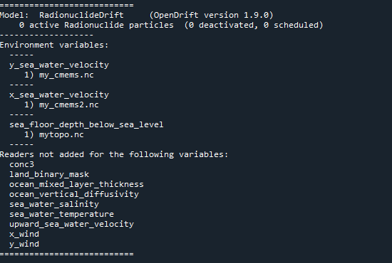
資料 CMEMS、ETOPO2
範例使用的資料
cmems
使用CMEMS的資料會缺乏一些參數，是可以跑的，但有一些過程會不去運算，像是風力作用等等。

Slide 4
該模型(radionuclides)的變數
=============================================
general:use_auto_landmask [True]
general:coastline_action [stranding]
general:time_step_minutes [60]
general:time_step_output_minutes [None]
seed:ocean_only [True]
seed:number [1]
drift:max_age_seconds [None]
drift:advection_scheme [euler]
drift:current_uncertainty [0]
drift:current_uncertainty_uniform [0]
drift:horizontal_diffusivity [0]
drift:wind_uncertainty [0]
drift:relative_wind [False]
drift:deactivate_north_of [None]
drift:deactivate_south_of [None]
drift:deactivate_east_of [None]
drift:deactivate_west_of [None]
seed:origin_marker [0]
seed:z [0]
seed:wind_drift_factor [0.02]
seed:current_drift_factor [1]
seed:terminal_velocity [0.0]
seed:diameter [0.0]
seed:neutral_buoyancy_salinity [31.25]
seed:density [2650.0]
seed:specie [0]
environment:constant:x_sea_water_velocity [None]
environment:fallback:x_sea_water_velocity [None]
environment:constant:y_sea_water_velocity [None]
environment:fallback:y_sea_water_velocity [None]
environment:constant:x_wind [None]
environment:fallback:x_wind [0]
environment:constant:y_wind [None]
environment:fallback:y_wind [0]
environment:constant:land_binary_mask [None]
environment:fallback:land_binary_mask [None]
environment:constant:sea_floor_depth_below_sea_level [None]
environment:fallback:sea_floor_depth_below_sea_level [None]
environment:constant:ocean_vertical_diffusivity [None]
environment:fallback:ocean_vertical_diffusivity [0.0001]
environment:constant:ocean_mixed_layer_thickness [None]
environment:fallback:ocean_mixed_layer_thickness [50]
environment:constant:sea_water_temperature [None]
environment:fallback:sea_water_temperature [10]
environment:constant:sea_water_salinity [None]
environment:fallback:sea_water_salinity [34]
environment:constant:upward_sea_water_velocity [None]
environment:fallback:upward_sea_water_velocity [0]
environment:constant:conc3 [None]
seed:particle_fraction [0.9]
seed:total_release [100000000000.0]
radionuclide:species:LMM [True]
radionuclide:species:LMMcation [False]
radionuclide:species:LMManion [False]
radionuclide:species:Colloid [False]
radionuclide:species:Humic_colloid [False]
radionuclide:species:Polymer [False]
radionuclide:species:Particle_reversible [True]
radionuclide:species:Particle_slowly_reversible [False]
radionuclide:species:Particle_irreversible [False]
radionuclide:species:Sediment_reversible [True]
radionuclide:species:Sediment_slowly_reversible [False]
radionuclide:species:Sediment_irreversible [False]
radionuclide:transformations:Kd [2.0]
radionuclide:transformations:Dc [1.16e-05]
radionuclide:transformations:slow_coeff [1.2e-07]
radionuclide:sediment:sedmixdepth [1]
radionuclide:sediment:sediment_density [2600]
radionuclide:sediment:effective_fraction [0.9]
radionuclide:sediment:corr_factor [0.1]
radionuclide:sediment:porosity [0.6]
radionuclide:sediment:layer_thick [1]
radionuclide:sediment:desorption_depth [1]
radionuclide:sediment:desorption_depth_uncert [0.5]
radionuclide:sediment:resuspension_depth [1]
radionuclide:sediment:resuspension_depth_uncert [0.5]
radionuclide:sediment:resuspension_critvel [0.01]
=============================================
environment:fallback:conc3 [0.001]
drift:vertical_advection [True]
drift:vertical_mixing [False]
vertical_mixing:timestep [60]
vertical_mixing:diffusivitymodel [environment]
vertical_mixing:background_diffusivity [1.2e-05]
vertical_mixing:TSprofiles [False]
drift:wind_drift_depth [0.1]
drift:stokes_drift [True]
drift:use_tabularised_stokes_drift [False]
drift:tabularised_stokes_drift_fetch [25000]
general:seafloor_action [lift_to_seafloor]
drift:truncate_ocean_model_below_m [None]
seed:seafloor [False]
radionuclide:transfer_setup [137Cs_rev]
radionuclide:slowly_fraction [False]
radionuclide:irreversible_fraction [False]
radionuclide:dissolved_diameter [0]
radionuclide:particle_diameter [5e-06]
radionuclide:particle_diameter_uncertainty [1e-07]
radionuclide:particlesize_distribution [normal]
seed:LMM_fraction [0.1]

Slide 5
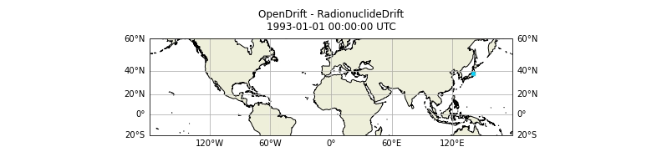
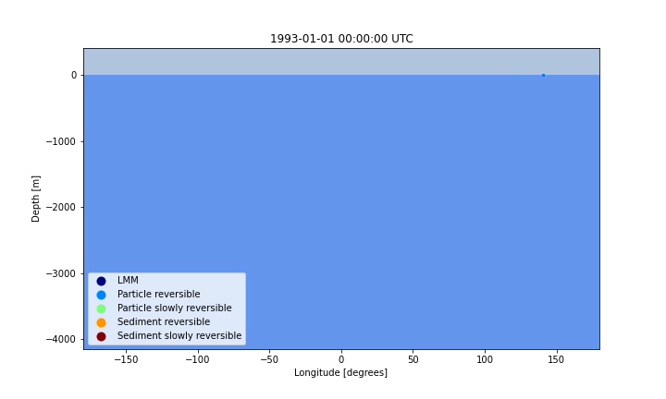
結果 seed : lats= 37.42;lon=141.07 time_step : 1day time_step_output=7day

